Slide 1
Youth Entrepreneurship – Challenges and Opportunities
Dr. Aneel Salman
Head, Department of Management Sciences
COMSATS University Islamabad

Slide 2
Young people make up 17 percent of the world’s population, but 40 percent of its unemployed.
Global unemployment rate is 4.5 percent, while the world youth unemployment rate is 12.6 percent.

Slide 3
What is
2+2=?

Slide 4
Two Most Powerful Words?

Slide 5
I am

Slide 6
Am I

Slide 7
Markets are Real
but
Ruthless

Slide 8
Times are Changing…..
Scientists Turn Entrepreneurs S&T Research Budget Research Output is Higher

Slide 9
“When some of these [academics] become millionaires and ride Porsches, the wives of others will needle them to go in this direction”
Sushanto Mitra, CE-Society for Innovation and Entrepreneurship at IIT-B

Slide 10


Slide 11
What and How???
Faculty Entrepreneurship Connecting with VCs Sabbaticals and Start Ups File Patents

Slide 12
Take Equity
Set up Incubators PhD theses for Potential IP Reducing Teaching Load

Slide 13
What's Happening??
Cultural Change in Institutions
Research with an Application Lens
Student-Professor Relationship to Partnership
Sponsored or Collaborative research
Risk Takers

Slide 14
Not Impact Factors
But
Imp ACT

Slide 15
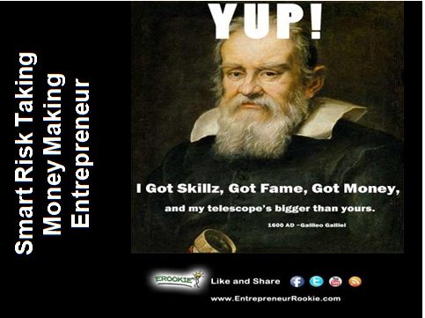

Slide 16

Scientists Turn Entrepreneurs Recipe

Slide 17
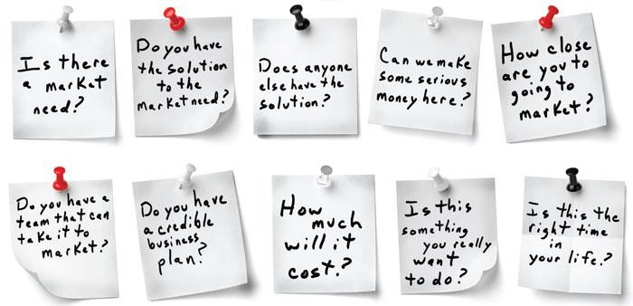
Things to do…

Slide 18


Slide 19
THE BIG DEAL…
Entrepreneurship ecosystems:
Cult status in policy speeches
Holy Grail for governments around the world
WHY? WHY…
ESPECIALLY WHEN NUMEROUS VCs BELIEVE…

Slide 20
Entrepreneurs are…
first born….ONLY born
belong to a entrepreneurial family
school/ college dropouts
had weird relationship with father

Slide 21
Entrepreneurship: main contributions
Employment Innovation Growth
Local and Regional Development Equalization of Opportunities Economic Power Dissemination

Slide 22
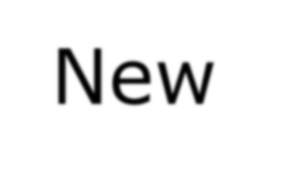
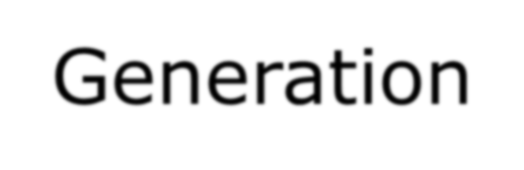
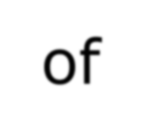
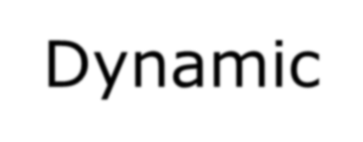
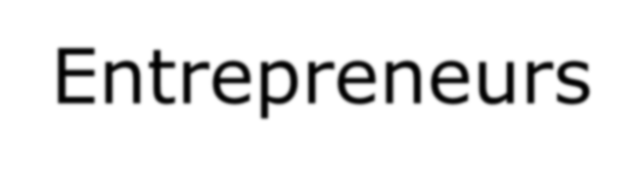
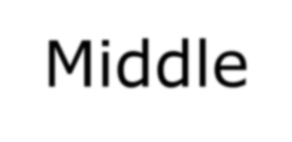

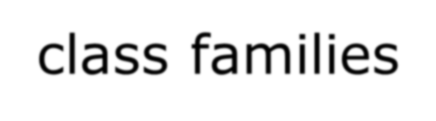
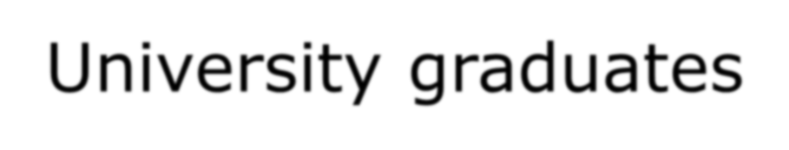
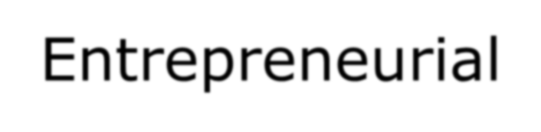
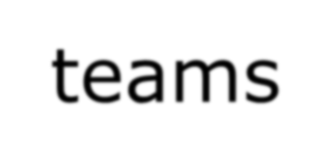
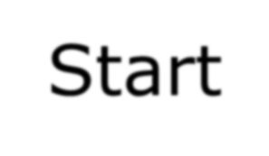
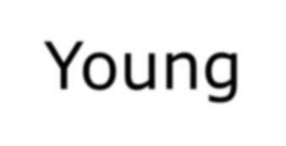
New Generation of Dynamic Entrepreneurs
Middle-class families University graduates Entrepreneurial teams Start Young

Slide 23
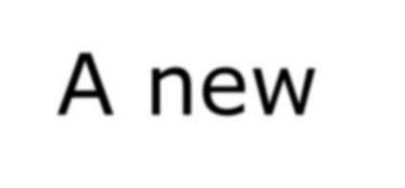

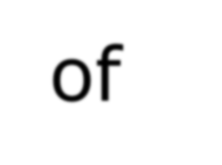

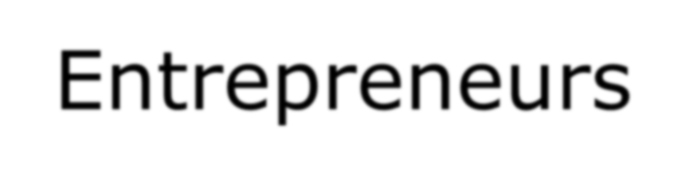
A new Generation of Dynamic Entrepreneurs
5 Main Initial Motivations:
To achieve self realization
To put their knowledge into practice
To increase their income
To be their own boss
To contribute to society

Slide 24
Advantage of promoting youth entrepreneurship
More employers
Employees who better understand business More innovative and socially responsible enterprises
More jobs (most likely jobs for other young people)
Better informed consumers
24

Slide 25
Transitions in the process of Youth Entrepreneurship Development
Pre-entrepreneurs (15-19 )
Budding Entrepreneurs (20-25) Emergent Entrepreneurs (26-29 )

Slide 26
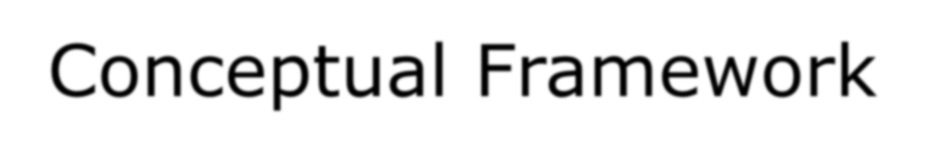
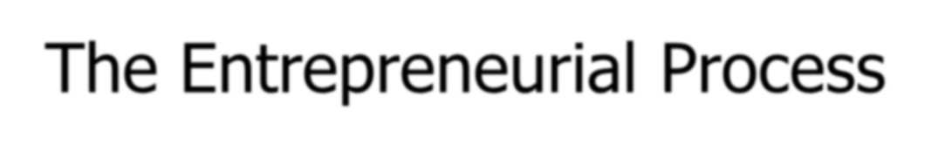



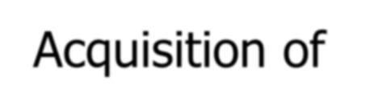
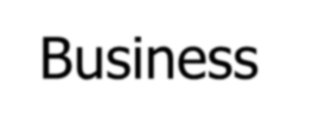


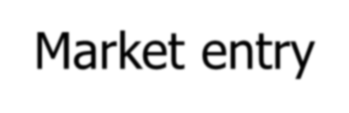
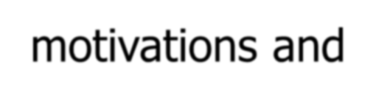
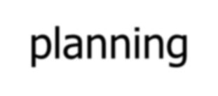
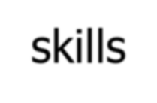
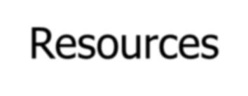
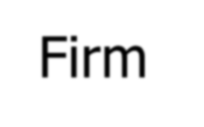
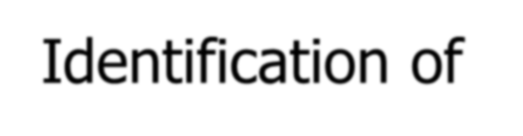


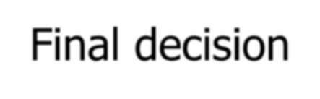
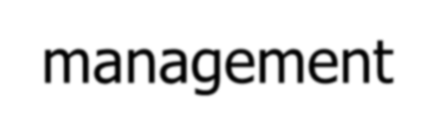
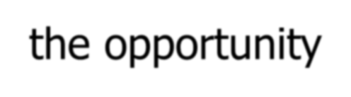

Conceptual Framework
The Entrepreneurial Process
Inception
Start-up
Early Years
➔ Acquisition of motivations and skills
➔ Identification of
the opportunity
➔ Business planning
➔ Resources
➔ Final decision
➔ Market entry
➔ Firm
management

Slide 27
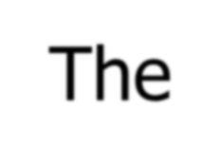

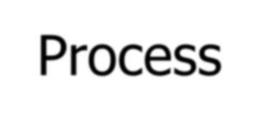
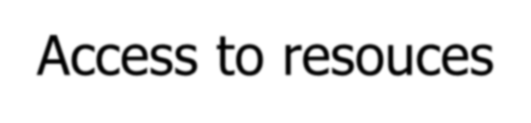
Conceptual Framework
The Entrepreneurial Process
Inception
Start-up
Early Years
➔ Acquisition of motivations and skills
➔ Identification of
the opportunity
➔ Business planning
➔ Access to resouces
➔ Final decision
➔ Market entry
➔ Firm
management

Slide 28
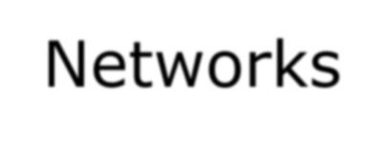
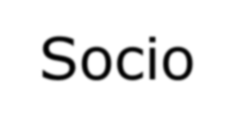

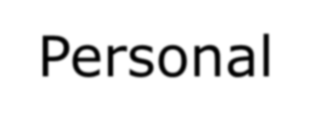


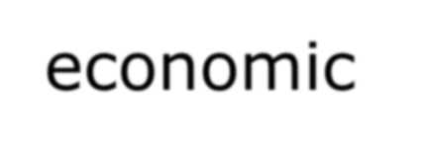
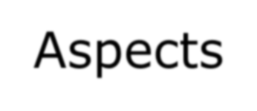
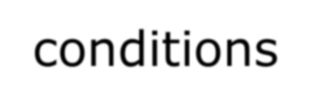
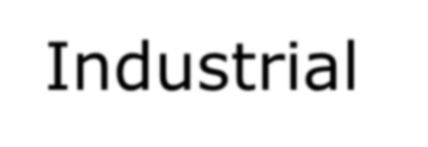
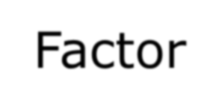
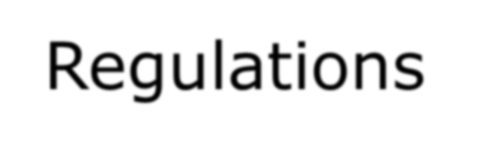
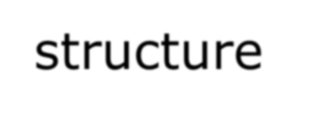
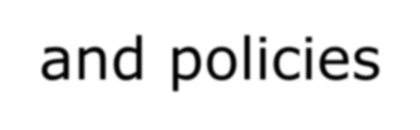
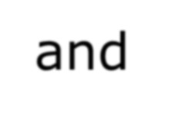
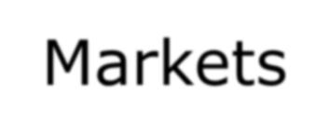
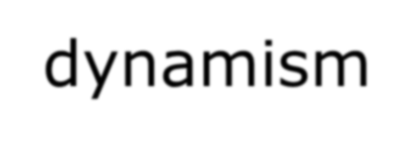
The Entrepreneurial Development System
Culture and educational system
Networks
Socio- economic conditions
Personal
Aspects
Inception
Start-up
Early years
Industrial structure and dynamism
Factor Markets conditions
Regulations and policies

Slide 29
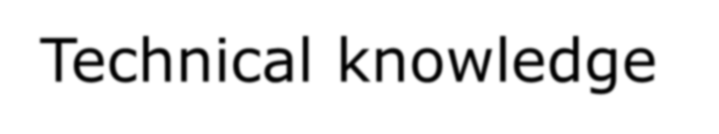
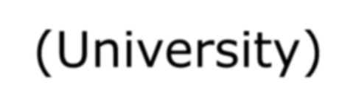

Key factors influencing the entrepreneurial process
Technical knowledge (University)

Slide 30




Key factors influencing the entrepreneurial process
Entrepreneurial competences (work experience)

Slide 31



Key factors influencing the entrepreneurial process
Entrepreneurial
teams

Slide 32


Key factors influencing the entrepreneurial process
Projects profile

Slide 33


Key factors influencing the entrepreneurial process
Networks

Slide 34

Key factors influencing the entrepreneurial process
Bootstrapping

Slide 35













Key factors influencing the entrepreneurial process
Technical knowledge (Univ)
Teams
Networks
Entrepreneurial
Projects profile ^{Bootstrapping}
competences
(work experience)

Slide 36



Typical negative factors
Culture & social structure

Slide 37





Typical negative factors
Entrepreneurial competences (educational system)

Slide 38



Typical negative factors
Institutional networks

Slide 39




Typical negative factors
Links with large
companies (industry structure)

Slide 40


Typical negative factors
Finance

Slide 41















Typical negative factors
Links with large
companies
Entrepreneurial competences (educational system)
Regulatory framework
Finance
Culture & social
structure

Slide 42
HOW?
E-ship is not just genetic or familial: It CAN be
LEARNED!

Slide 43
E-ship Revolution: Step 1
Get INVOLVED in:
Student projects
Student societies
Something outside your core department
Any activity to broaden your perspective

Slide 44
Still Unsure??
Step 2
Hot stove test
Is the glass half full?
See around the mountain
Perseverance
Work with teams

Slide 45
Step 3: Team Up
NO one individual is perfect. but
A TEAM can come close!
Investors only back teams.

Slide 46
Step 4: Business Plan
Its about YOUR intelligence And NOT your Bios!
Format: Simple and perfect.
No excuses allowed if you have a web browser.
The tricky bit: Financials!
No harm in ASKING FOR HELP!

Slide 47
Step 5: Wear The Investor’s Shoes
What it looks like from his/her perspective.
– Dozens of business plans per week.

Slide 48
Step 6: Intro
You need an introduction.
Ideally from someone who has written a cheque.
Who has credibility esp. with the investor.

Slide 49
Oh And Of Course You Need
Superb public relations and communication skills!

Slide 50
SO…What is MOST important..
What is MOST important in determining whether YOU will make really BIG $ in
YOUR first entrepreneurial venture?
management?
innovation?
hard work?
luck?

Slide 51
LUCK!
Was a bit of a trick question.
Zero doubt that this is the correct answer.

Slide 52
Sorry it’s not easier!

Slide 53
“The biggest risk is not taking any risk… In a world that changing really quickly, the only strategy that is guaranteed to fail is not taking risks.”
– Mark Zuckerberg, Facebook

Slide 54
Thank You
Dr. Aneel Salman Department of Management Sciences
COMSATS Institute of Information Technology Islamabad, Pakistan
E: aneel.salman@comsats.edu.pk

